Slide 1


Data Exploration

Slide 2
What is Data?
Any collection of facts, figures, or other information that can be processed, analyzed, and interpreted to derive insights, knowledge, and understanding of a particular phenomenon or domain. Data can take many forms, including text, numbers, images, audio, and video.
Data is typically stored and processed using digital technologies, such as databases, spreadsheets, and programming languages.

Slide 3
Types of Data
Data can be categorized into various types, such as structured data, semi-structured data, and unstructured data.
Structured data: Highly organized and can be easily processed and analyzed,
Unstructured data: Text, images, and videos, and requires more advanced processing techniques such as natural language processing and computer vision.
Semi-structured data: May include elements of both text and data, and may be stored in a variety of formats, including

Slide 4
Why is Data Important?
Improved decision-making: Data provides a basis for informed decision-making, allowing individuals and organizations to make more accurate and effective decisions.
Increased efficiency: Data can be used to optimize and streamline operations, reduce waste, and increase productivity.
Better customer experiences: Data can be used to understand customer needs and preferences, and to personalize products and services to meet those needs.
Innovation: Data provides a basis for innovation and discovery, enabling new products and services to be developed and new markets to be created.
Improved public policy: Data can be used to inform public policy decisions, and to monitor and evaluate the effectiveness of policies and programs.

Slide 5
What is Data Exploration?
The process of analyzing and visualizing data to gain insights and understanding of the underlying patterns, trends, and relationships in the data.
A crucial step in the data analysis process, as it helps to identify potential outliers, data quality issues, and interesting patterns or correlations that can guide further analysis.

Slide 6
Why is Data Exploration important in Machine Learning?
Feature selection: Data exploration can help us identify the most important features or variables in our dataset, which can help us select the best features for our machine learning models.
Data cleaning: Data exploration can help us identify missing values, outliers, and other data quality issues, which we can then address through data cleaning techniques.
Model selection: Data exploration can help us identify which machine learning algorithms may be most appropriate for our dataset, based on the structure and characteristics of the data.

Slide 7
Why is Data Exploration important in Machine Learning?
Model evaluation: Data exploration can help us evaluate the performance of our machine learning models, by identifying areas where the model is underfitting or overfitting the data.
Data understanding: Data exploration can help us gain a deeper understanding of the data we are working with, and may even lead to new insights and hypotheses about the underlying phenomenon we are studying.

Slide 8
Coding Lab

Slide 9
Python Libraries - Pandas
Data structures: Pandas provides two main data structures for storing and manipulating data: Series and DataFrame. A Series is a one-dimensional array-like object that can hold any data type, while a DataFrame is a two-dimensional table-like data structure that can hold multiple types of data.
Data manipulation: Pandas provides a wide range of functions for manipulating and transforming data, such as filtering, sorting, grouping, merging, and reshaping.
Missing data handling: Pandas provides functions for detecting and handling missing data, such as filling in missing values or dropping rows or columns with missing data.
Time series analysis: Pandas provides functions for working with time series data, such as resampling, time shifting, and rolling window calculations.
Input/output: Pandas provides functions for reading and writing data in various formats, such as CSV, Excel, SQL, and JSON.

Slide 10
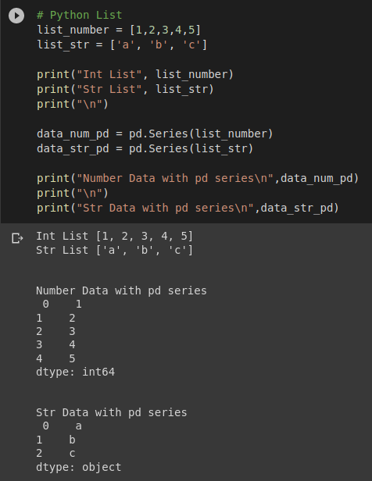
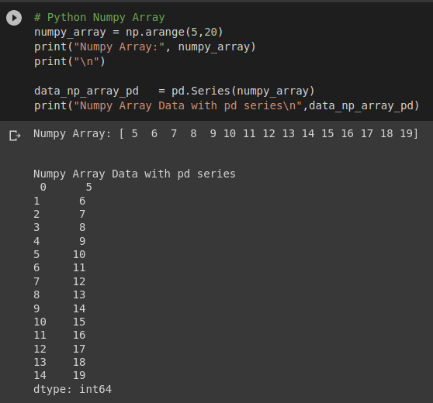
Creating Pandas Series from List or Numpy

Slide 11
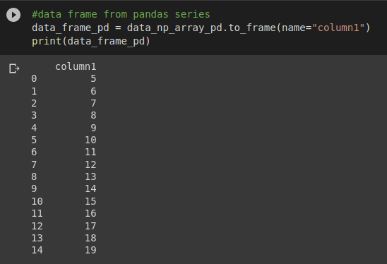
Creating Dataframe from Series

Slide 12
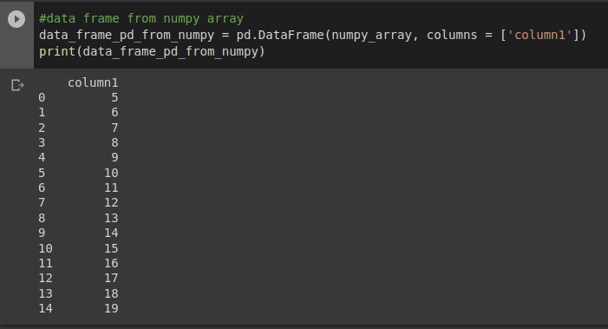
Creating Dataframe from Numpy

Slide 13
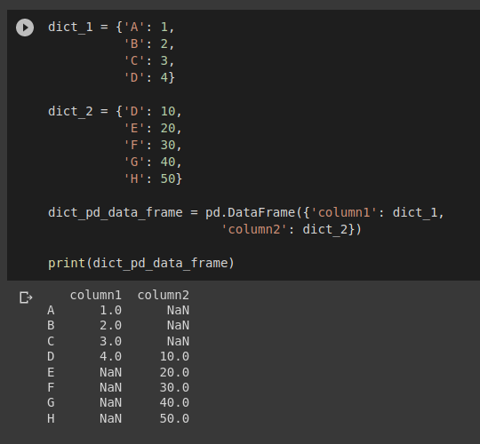
Creating Dataframe from Dictionary

Slide 14
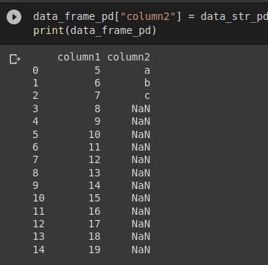
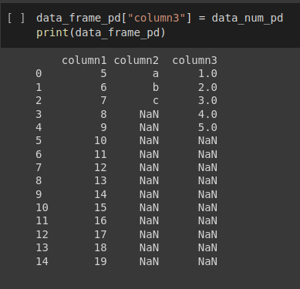
Adding new columns to Dataframe

Slide 15
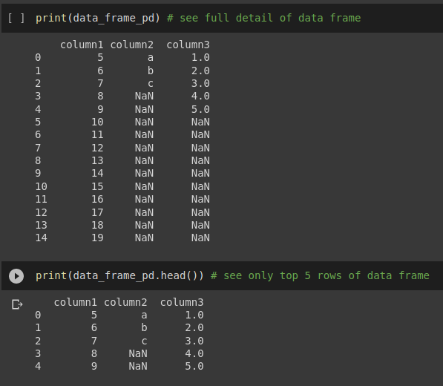
Data Exploration

Slide 16
Indexing and Slicing
In Machine Learning and Data Science, it is important to know how to perform indexing and slicing
In python, list, array or Dataframe have same format for indexing and slicing.
from start to end >>
Start index: 0
End index: (positive value of length of list, array or dataframe) - 1
from end to start >>
Start index: negative value of length of list, array or dataframe
End index: -1

Slide 17
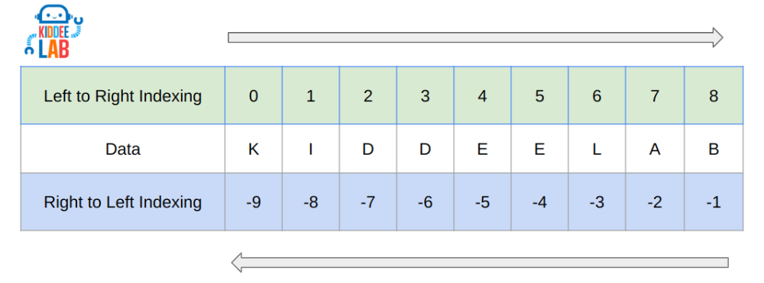
Indexing and Slicing

Slide 18

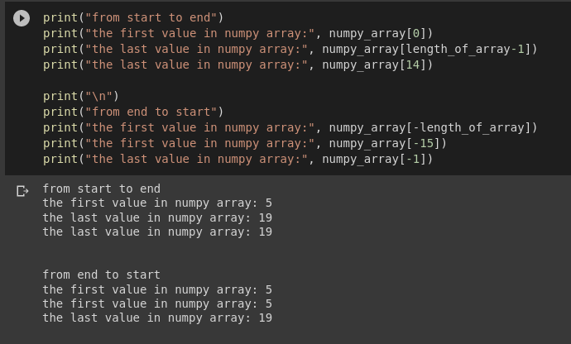
Indexing

Slide 19
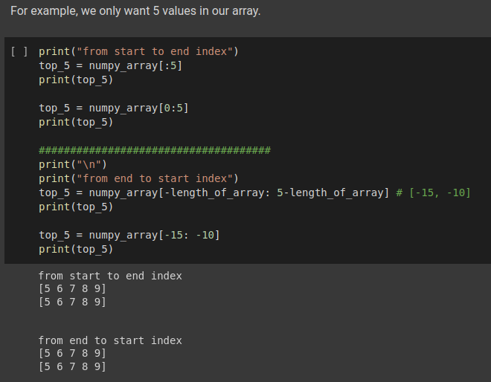
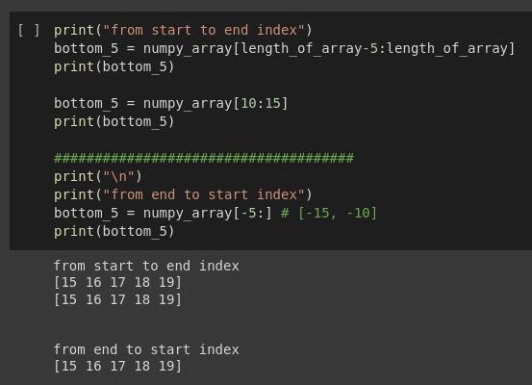
Slicing - Numpy

Slide 20
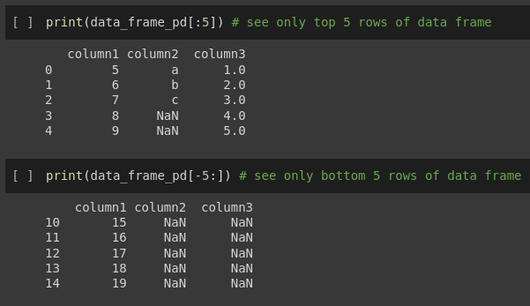
Slicing - Dataframe

Slide 21
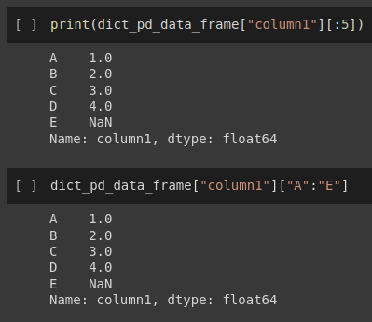
Slicing - Dataframe

Slide 22
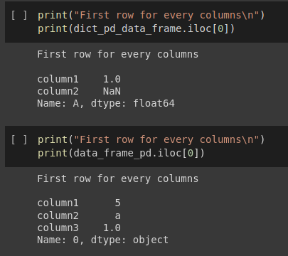
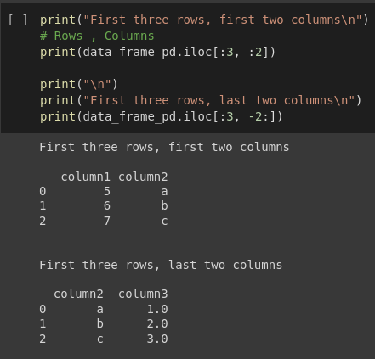
iloc for indexing and slicing

Slide 23
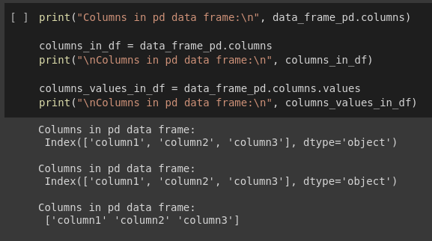
Extracting Column Names from Dataframe

Slide 24
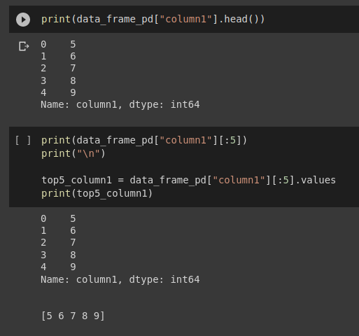
Extracting Values from Specific Columns in Dataframe

Slide 25
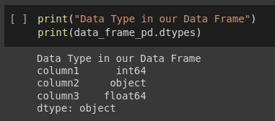
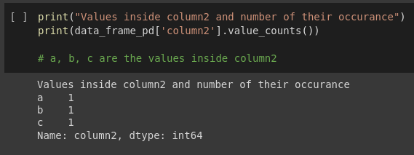
Checking Data Types

Slide 26
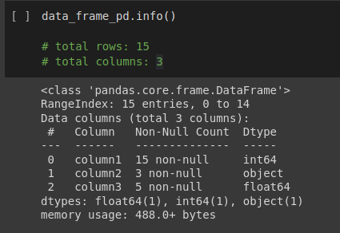
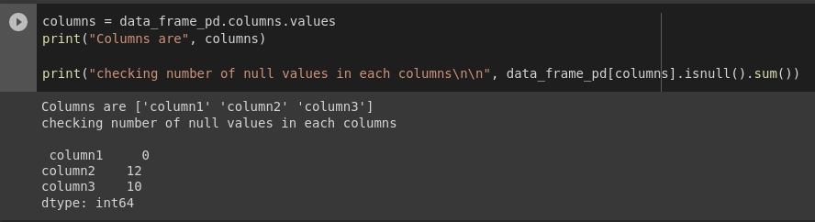
Checking Missing Values

Slide 27
Python Libraries - Seaborn
A data visualization library for Python that is built on top of the matplotlib library.
It provides a high-level interface for creating informative and visually appealing statistical graphics, such as heatmaps, histograms, scatter plots, and line plots.
Seaborn makes it easy to create complex visualizations with minimal code by providing a range of pre-built plot types and a set of built-in color palettes that are optimized for data visualization.
It also offers advanced features like automatic data transformations, integration with Pandas data structures, and the ability to customize plot aesthetics.

Slide 28

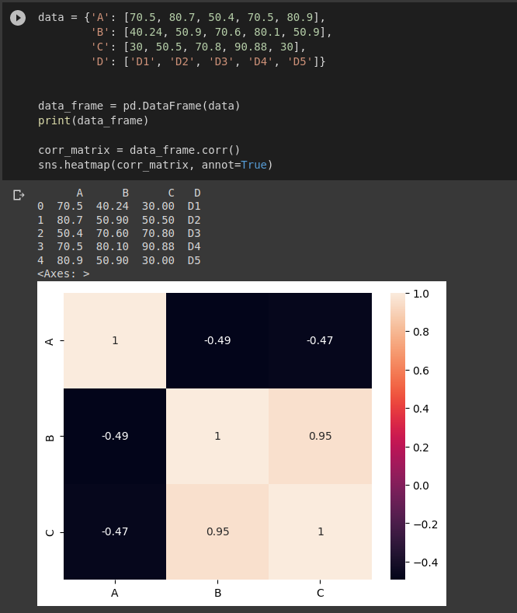
Feature Selection
Heat Map Plot is normally used for correlation matrix. Only works well if the data are in numeric (int or float)
What is features?
Features = Column Names
How to read correlation matrix?
-1 indicates a perfectly negative linear correlation between two variables
0 indicates no linear correlation between two variables
1 indicates a perfectly positive linear correlation between two variables
Closer to 0, lower correlation.
Closer to 1 or -1, higher correlation.

